Slide 1

Walking patterns recognition under real world conditions
Russo, Nastastic, Cernigliaro, Broniarek, Alliende

Slide 2

Main research aim
Main goal: verify if there are different patterns of walking among the group members of this project.
Secondary goals:
Perform a multi-resolution analysis: analyze if the elicitation of the length of the window selected to divide the data affects the results of the classification
To make Francesco walk more than 10 minutes at once

Slide 3

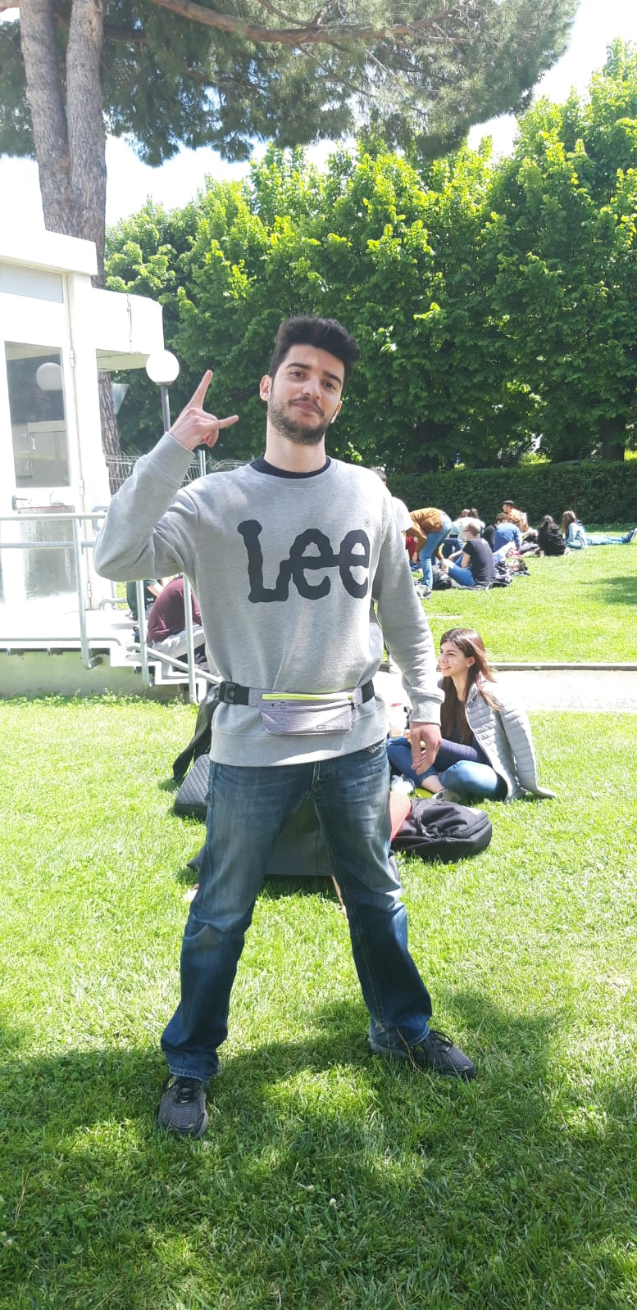
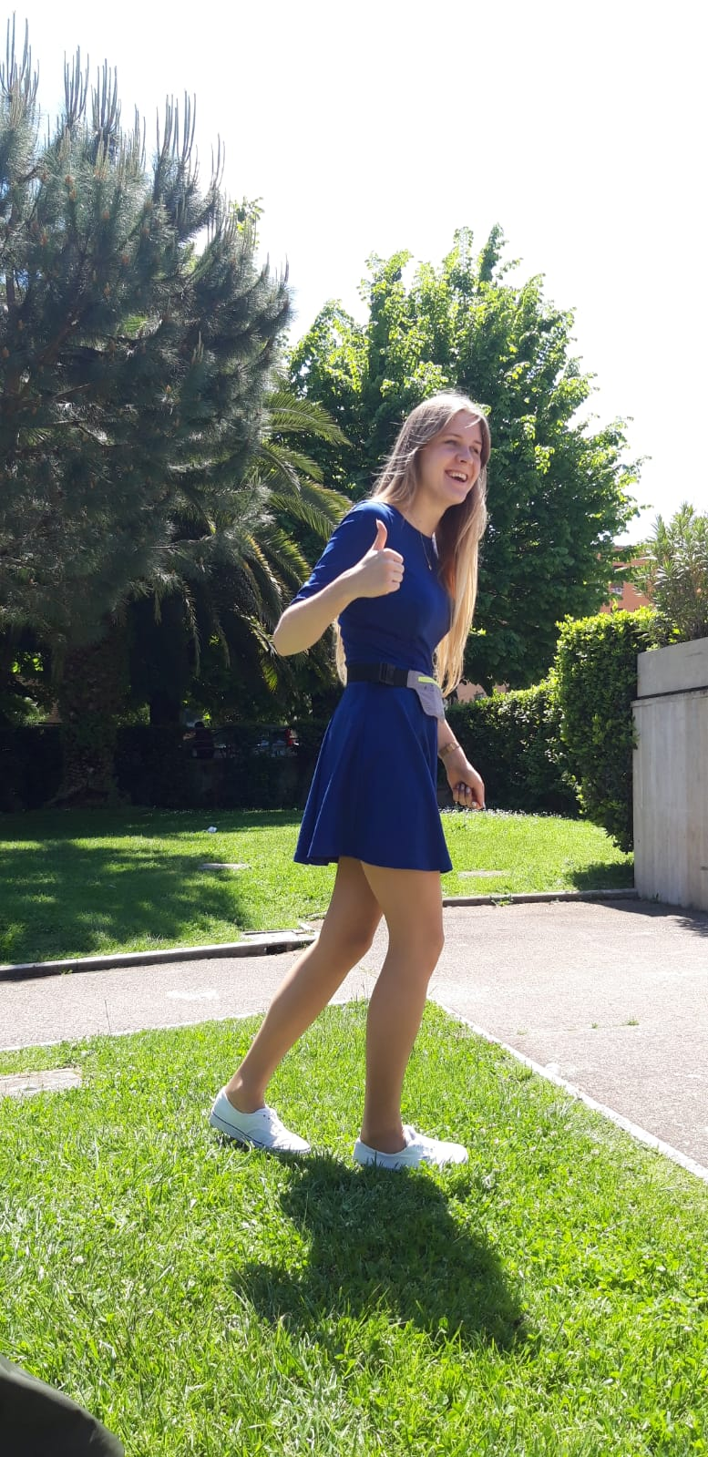



Data collection

Slide 4

The Data
5 files, one for each person of the group
About 25 minutes of recording
Used sensors:
Linear Accelerometer Sensor
Acceleration on the x axis
Acceleration on the y axis
Acceleration on the z axis

Slide 5

Data Pre-processing
Dealing with noisy data:
Removed 1 minute on the beginning and 1 minutes on the end of each recording
Time bins
Window and overlap → starting values: 500, 200
Coming soon: Multiresolution Analysis

Slide 6
Data Pre-processing
Feature Generation:
Average acceleration for each axis and linear acceleration
Standard deviation for each axis and linear acceleration
Average Absolute Difference → linear acceleration average on the time window.

Slide 7
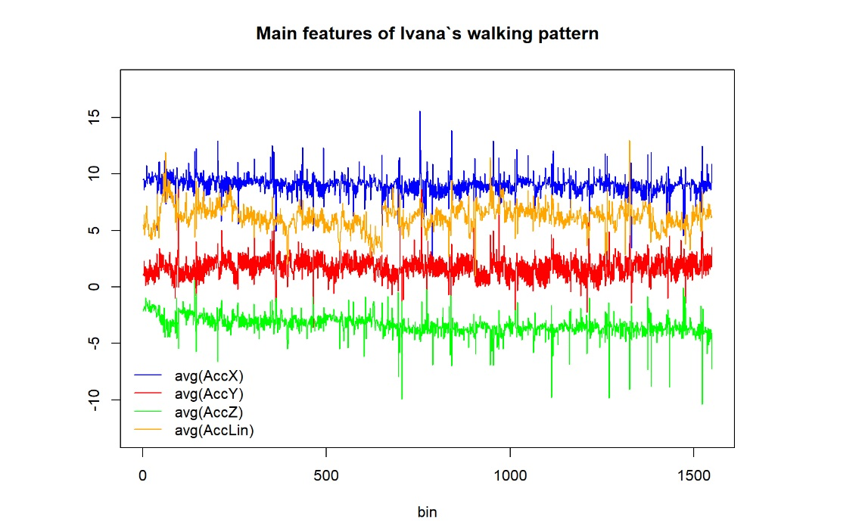

Slide 8

Modeling
Used algorithms:
Random Forest
Linear Discriminant Analysis
Naive Bayes (parametric)
LASSO Logistic Regression
k-Nearest Neighbours
SVM
Stacking Model from the best 3 models
* Training set: 80% of the data

Slide 9

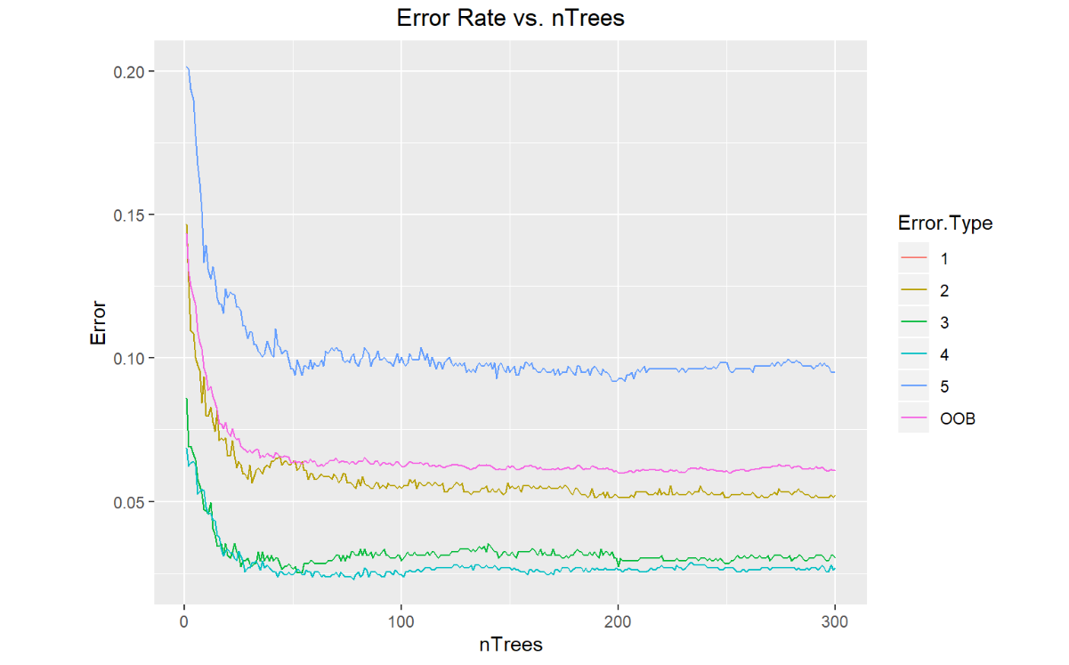

Random Forest Parameter elicitation
Number of trees: 150

Slide 10

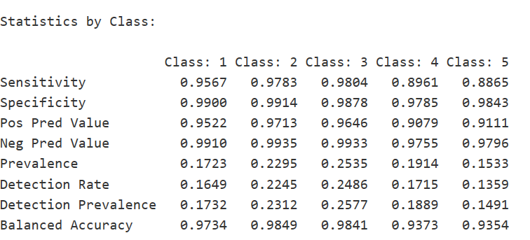
Random Forest Results
Train Missclassification rate | 6.3
Test Missclassification rate | 5.47
Accuracy | 0.9453

Slide 11
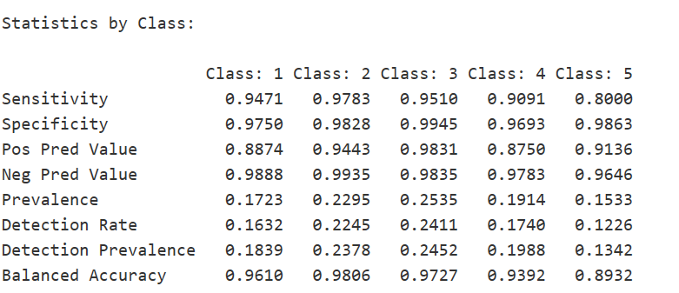
LDA Results
Train Missclassification rate | 8.41
Test Missclassification rate | 7.46
Accuracy | 0.9254

Slide 12
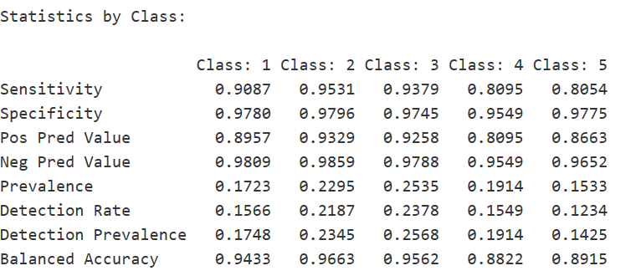
Naive Bayes (parametric) Results
Train Missclassification rate | 9.82
Test Missclassification rate | 10.85
Accuracy | 0.8915

Slide 13
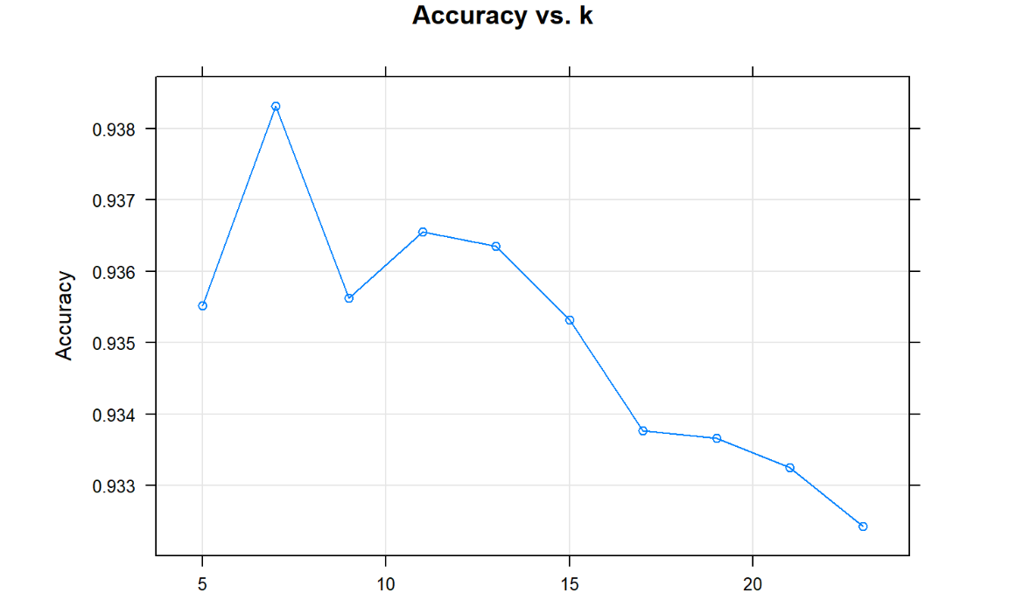
k-Nearest Neighbor Parameter elicitation
k= 7

Slide 14
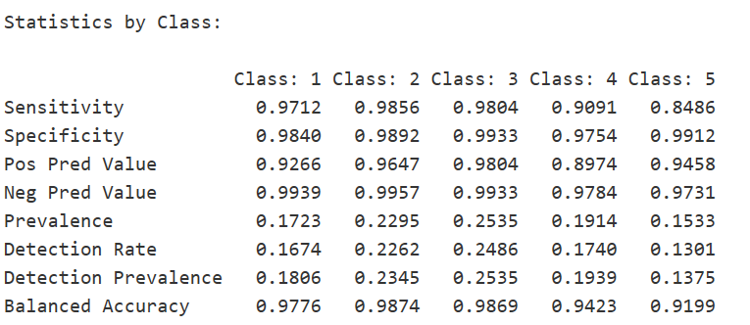
k-Nearest Neighbor Results
Train Missclassification rate | 4.79
Test Missclassification rate | 5.39
Accuracy | 0.9461

Slide 15
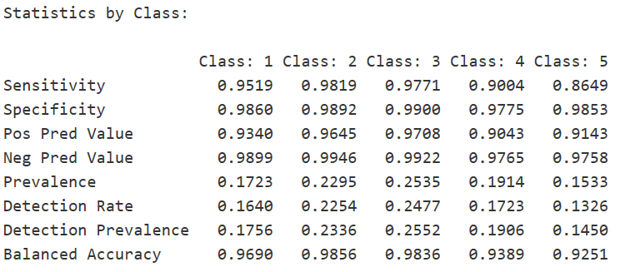
LASSO Logistic Regression Results
Train Missclassification rate | 6.59
Test Missclassification rate | 5.8
Accuracy | 0.942

Slide 16
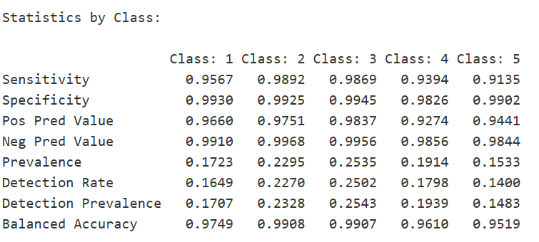
SVM Results
Train Missclassification rate | 3.7
Test Missclassification rate | 3.81
Accuracy | 0.9619

Slide 17

Stacking Model Metodology
Best four models: k-NN, Random Forest, LASSO and SVM. The idea is to use
Predictions of majority.
If each classifier returns different class → k-NN.

Slide 18
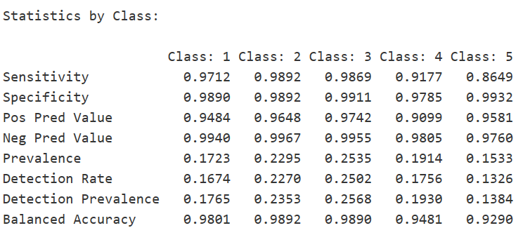
Stacking Model Results
Test Missclassification rate | 4.72
Accuracy | 0.9528

Slide 19

Preliminar Ranking
1. SVM: 0.962
2. Stacking: 0.953
3. k-NN: 0.946
4. Random Forest: 0.943
5. LASSO: 0.942
6. LDA: 0.925
7. Naive Bayes: 0.892

Slide 20
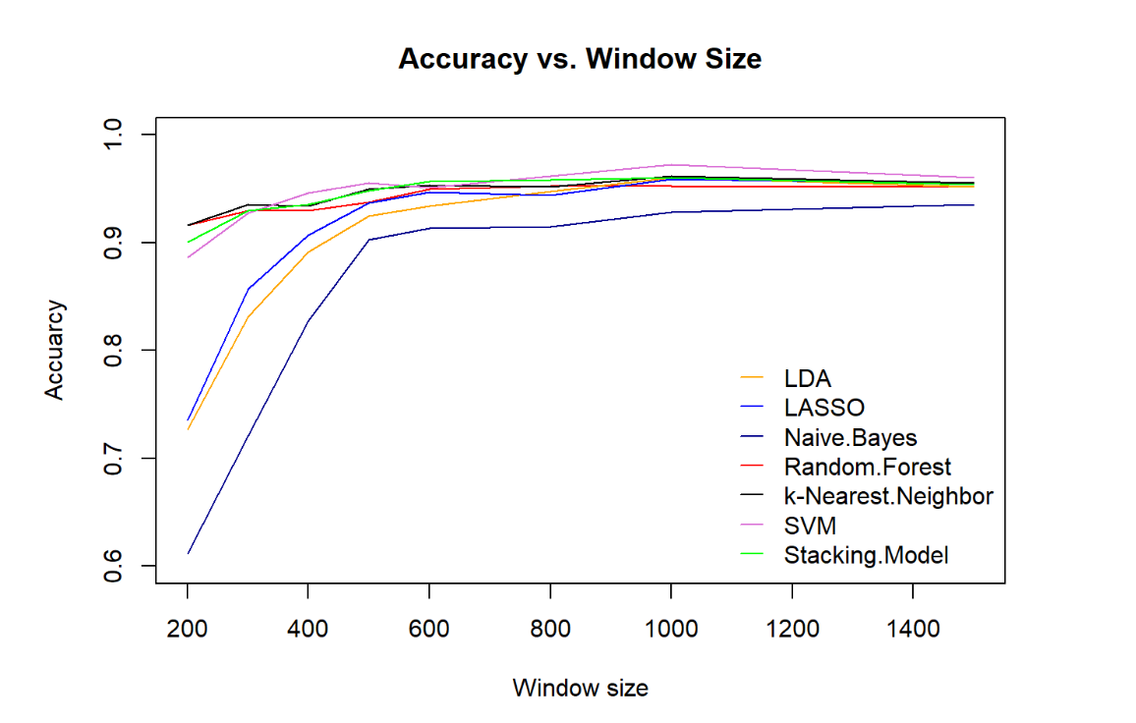
Multiresolution Analysis
Window size: 1000
Overlap: 400
Clean data
Create bins
Model
Feature Generation
Results

Slide 21
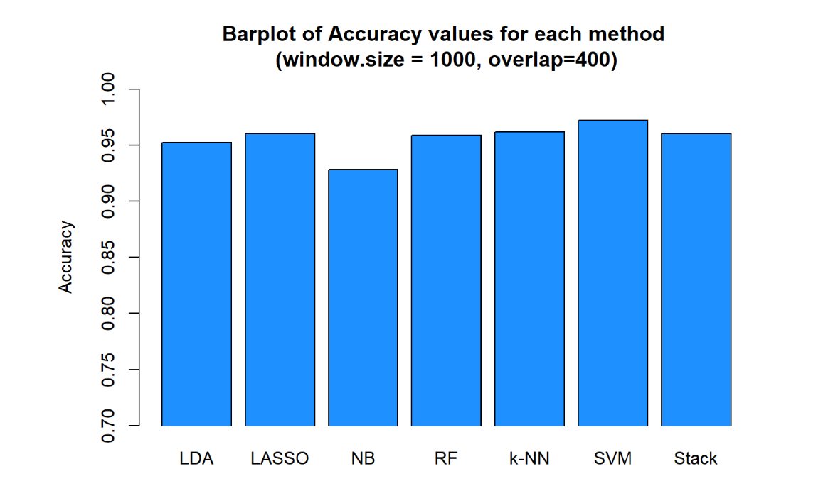

Comparing Models

Slide 22

Conclusions
Final Ranking
Top 1: SVM
The biggest looser: Naive Bayes
Window size → not relevant influence on the accuracy after reaching a size of around 1 second

